Slide 1














HEART HEALTH
PREADICTOR

Slide 2




AKSHAT RAJ
2016181
IT
AMAN KUMAR SINGH
2016183
IT
GROUP MEMBERS
ANIMIT DASH
2016186
IT
RITESH RANJAN
2016243
IT

Slide 3

INTRODUCTION:
Cardiovascular disease (CVD) remains a leading cause of global mortality, driven by sedentary lifestyles and poor diets. Despite medical advancements, its prevalence rises, particularly in underserved areas lacking healthcare access. Early detection is crucial, yet challenging due to limited resources and expertise in remote regions. This exacerbates CVD's impact, underscoring the need for improved infrastructure and strategies to ensure timely diagnosis and management, ultimately enhancing patient outcomes and reducing the burden of disease.

Slide 4
CONTEXT
The World Health Organization (WHO) has estimated that 12 million deaths occur worldwide, every year due to the Heart diseases.
Limited access to specialized medical facilities exacerbates challenges in addressing the rising incidence of cardiovascular diseases (CVDs).
Inadequate infrastructure for continuous patient monitoring hinders early detection and treatment of CVDs.
High costs associated with conventional diagnostic techniques create barriers to timely diagnosis and management of CVDs.
Subjective clinical evaluations and manual analysis of medical data introduce variability and errors in disease diagnosis and prognosis.
The burden of heart diseases is disproportionately high, with a significant number of deaths occurring annually, especially in urban areas, and is expected to escalate globally by 2030, posing significant challenges to healthcare systems.

Slide 5
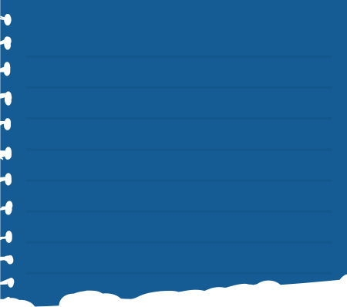

OBJECTIVES
MAIN OBJECTIVE
SECONDARY OBJECTIVES
Develop machine learning prediction models utilizing healthcare data to enhance early detection and risk stratification of cardiovascular diseases (CVDs), aiming to improve prognosis and enable proactive interventions.
Integrate machine learning algorithms into healthcare systems to empower providers with predictive analytics tools for more efficient and targeted management of CVDs, ultimately improving patient outcomes and reducing healthcare burden.

Slide 6

METHODOLOGY:
Our methodology employs Keras to train logistic regression models using the sigmoid activation function. Despite the dataset having two classes labeled as 0 and 1, our objective is to gauge the severity of heart health rather than binary classification. The sigmoid activation function, prevalent in logistic regression, yields probabilities rather than discrete class labels, aligning with our goal. This approach allows us to assess the continuum of heart health, providing nuanced insights beyond binary categorization. Through leveraging Keras and the sigmoid activation function, our methodology aims to offer a more comprehensive understanding of cardiovascular health status for improved healthcare decision-making.

Slide 7


MODULE DESCRIPTION
Data Collection Module
Data Preprocessing Module
Model Training Module
Gathering crucial data from electronic health records, wearables, and patient surveys for comprehensive analysis.
The collected data undergoes cleaning and organization to ensure its accurate and consistent.
Multiple machine learning models are trained using the cleaned-up data, and their performance is checked to see how well they predict heart problems.
Model Deployment Module
05
User Interface Module
The best-performing model is turned into a web service using Flask, which allows it to be accessed remotely and used with other systems.
This part creates an easy-to-use interface where healthcare workers can enter patient data and get predictions from the model.

Slide 8
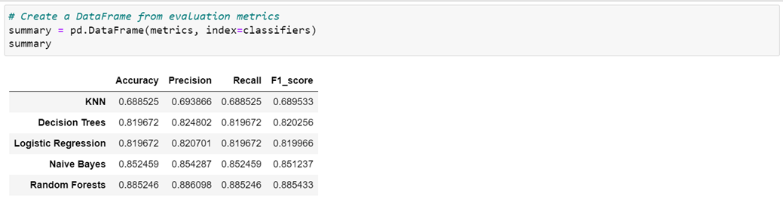
RESULT ANALYSIS

Slide 9

CONCLUSION
Our project explores machine learning's potential in predicting cardiovascular diseases (CVDs). We evaluated five models: KNN, Decision Tree, Logistic Regression, Naive Bayes, and Random Forest. Random Forest led with 88% accuracy, followed by Naive Bayes at 85%. Logistic Regression showed promise at 81%, while Decision Tree and KNN achieved lower accuracies. Notably, Logistic Regression gauges severity, while others binary classify CVD presence. This underscores machine learning's efficacy in early CVD detection and risk assessment, facilitating preventative measures and personalized healthcare. Harnessing healthcare data and advanced analytics empowers professionals to improve patient outcomes and alleviate healthcare system burdens.

Slide 10
THANK YOU VERY MUCH!

